Slide 1

Ironhack Data Analysis
Module 1 Project
Agustin Arvilla, 2020 July

Slide 2
Description
EXECUTION
DATASETS
PYTHON LIBRARIES
OUTPUT
main_scrypt.py
--path (required)
--country (option)
Pipeline
main
m_acquisition
m_wrangling
m_analysis
DATABASE
raw_data_project_m1.db
JOBS INFORMATION API
http://dataatwork.org/data/
COUNTRY INFO EUROSTAT
https://ec.europa.eu/eurostat/statistics-explained/index.php/Glossary:Country_codes,
pandas
re
sys
argparse
datetime
os
sqlalchemy
requests
./data/results/
df_total_result.csv
df_total_result_Spain.csv
df_final_arg.csv
./data/processed/
df_total_data.csv
On screen
TOOLS
Pycharm, Jupyter Notebook

Slide 3
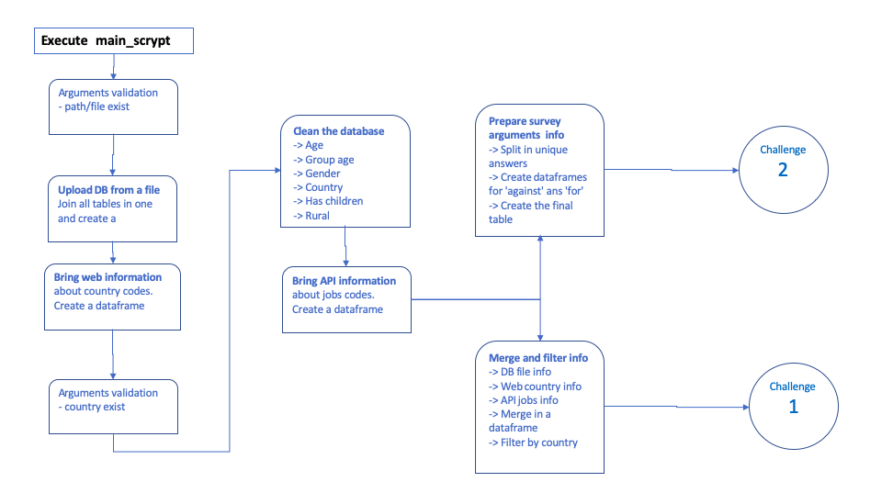
Work flow

Slide 4
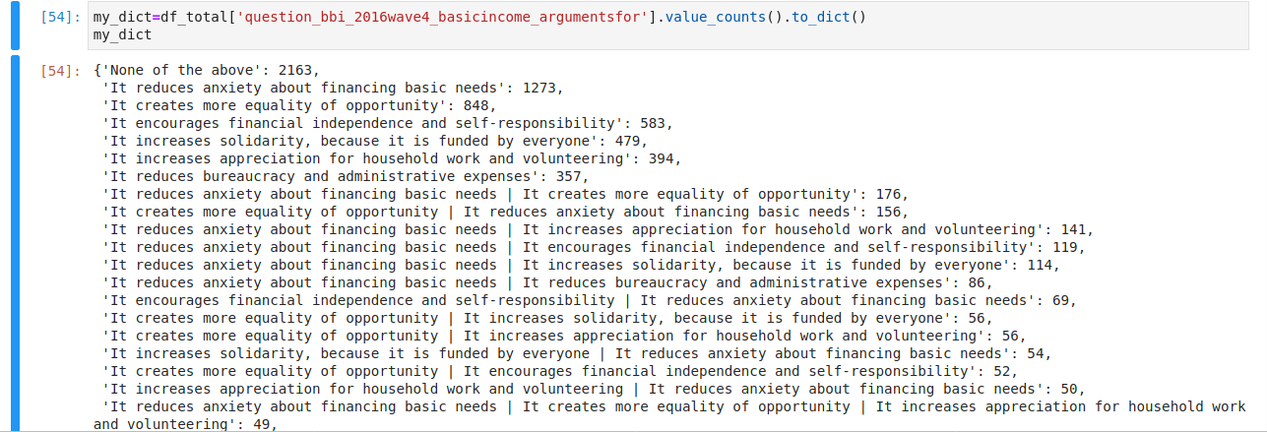
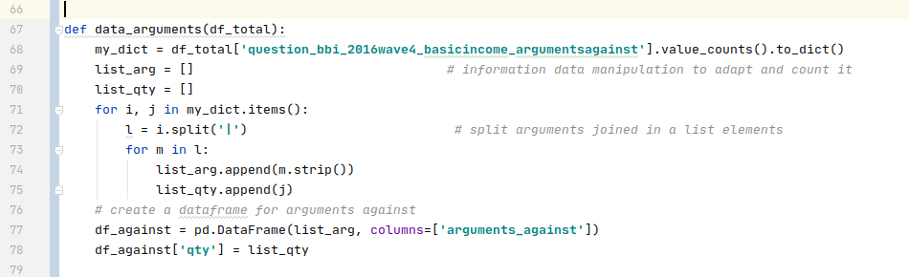
Code & problems

Slide 5
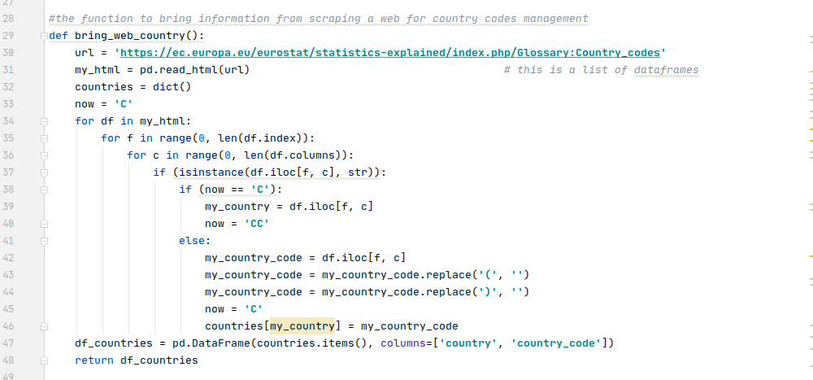
Code

